Slide 1
ELECTROMECHANICAL SYSTEM
Chapter 2: dEFiNITION and Principle of motor operationS

Slide 2
MOTOR CONTROL A motor control circuit can be defined as a means of supplying power to and removing power from a motor.

Slide 3
Electric motor
It is a machine which converts electric energy into mechanical energy or work and requires electric energy input.

Slide 4
Two Types of Electric motors
DC Motor
AC Motor

Slide 5
1. DC Motors
Operate on Direct Current from a battery or DC power supply.
They work on the principle that a conductor in a magnetic field experiences a mechanical force.

Slide 6
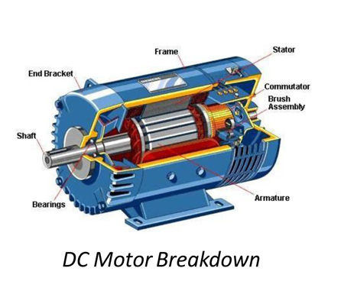
1. DC Motors

Slide 7
1. DC Motors
3 Basic Parts
Armature – The rotating part with wire coils around a core and a shaft that rotates on bearings.
Stator – The stationary part containing coils of wire.
Commutator – Terminated points on the armature where brushes make contact to transfer current from stationary to rotating parts.

Slide 8
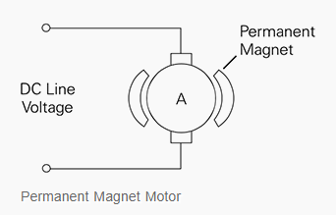
1. DC Motors
4 Basic types of DC motors
Permanent Magnet DC Motor – Uses a magnet for field flux.
Advantages: Excellent starting torque and good speed regulation.
Disadvantages: Limited load capacity, typically used in low horsepower applications; torque is limited to 150% of rated torque to avoid magnet demagnetization.

Slide 9
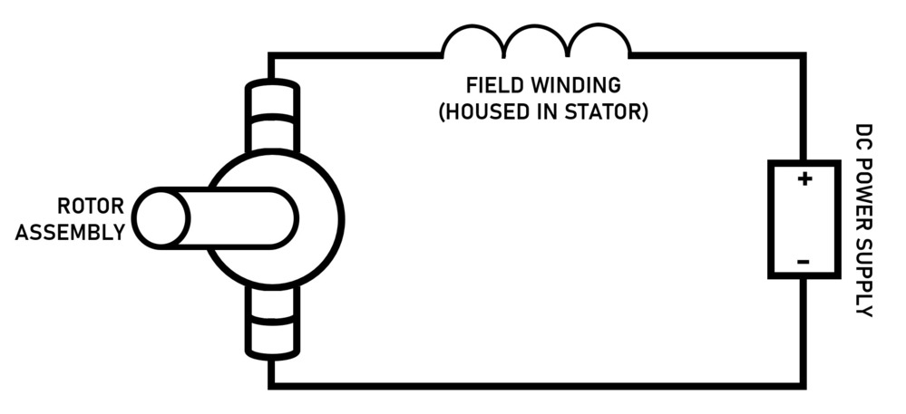
1. DC Motors
4 Basic types of DC motors
2. Series DC Motor – Provides high starting torque.
Advantages: Capable of moving large shaft loads when first energized.
Feature: Field winding and armature are connected in series

Slide 10
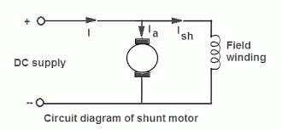
1. DC Motors
4 Basic types of DC motors
Shunt DC Motor – Field winding is connected in parallel with the armature.
Feature: Field windings consist of many turns of wire.

Slide 11
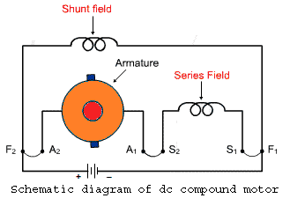
1. DC Motors
4 Basic types of DC motors
4. Compound DC Motor – Combines series and shunt motor features.
Series Field Winding: Connected in series with the armature.
Shunt Field Winding: Connected in parallel with the armature.
Benefits: Combines high torque and regulated speed.

Slide 12
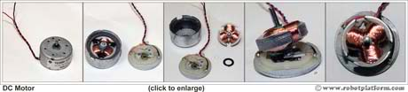
1. DC Motors
DC Motors for Mobile Robots
1. Brushed DC motor - Uses permanent magnets in the rotor and electromagnets in the stator.
Commutator: Detects rotor orientation and flips the current using brushes.
Function: Brushes rotate with the rotor to maintain current flow and motor operation.

Slide 13
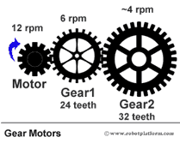
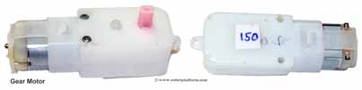
1. DC Motors
DC Motors for Mobile Robots
2. Geared DC motor - DC motor coupled with gears to increase torque while reducing speed.
Application: Commonly used in robots to pull weight and components.
Gear Mechanism: Motor shaft connects to gears, decreasing rpm and increasing torque.

Slide 14
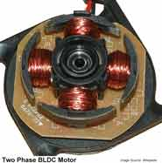
1. DC Motors
DC Motors for Mobile Robots
3. Brushless DC motors - Rotor uses permanent magnet, stator uses electromagnet, and Hall Effect sensors detect rotor orientation.
Advantages: Higher torque and greater speed than brushed motors, ideal for robots.
Disadvantages: Expensive due to design complexity, requires a controller for speed and rotation.

Slide 15
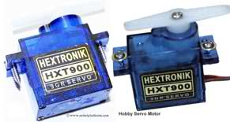
1. DC Motors
DC Motors for Mobile Robots
4. Servo Motors - DC motors with feedback control circuitry, gear system, and position sensing (potentiometer).
Function: Moves motor shaft to a desired position based on control signal (pulse).
Rotation: Limited to a specific range (usually 200°); can be modified for continuous rotation.
Wiring: Requires three wires: Ground, Power, and Control pulse.

Slide 16
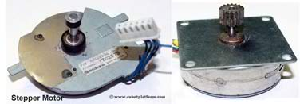
1. DC Motors
DC Motors for Mobile Robots
5. Stepper motors - Brushless motors that divide rotation into discrete steps with electrical pulses.
Function: Rotates in steps per revolution, jumping each step with a pulse.
Torque: Similar to brushed DC motors but with less torque.
Feedback: No complex position feedback required.

Slide 17
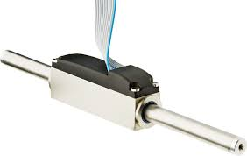
1. DC Motors
DC Motors for Mobile Robots
6. Linear DC motor - Stator unwrapped into a flat coil track.
Function: Rotor moves in a straight line over the stator.

Slide 18
2. AC Motors
Convert AC electrical power into mechanical power.
Operate on Alternating Current, oscillating between positive and negative.
Principle: Interaction between the revolving magnetic field in the stator and the opposing magnetic field in the rotor.

Slide 19
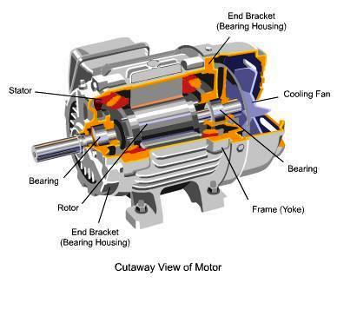
2. AC Motors

Slide 20
2. AC Motors
Basic Parts
Stator – fixed outer portion
Rotor – spins inside the AC motor
Air gap – Space between stator and rotor where energy is transferred via induction.

Slide 21
2. AC Motors
Classifications
According to their principle of operation
a. Synchronous motor
b. Asynchronous motor
Induction motors
Squirrel cage induction motor
Wound-rotor induction motor

Slide 22
2. AC Motors
Classifications
Commutator motor
Series motor – single phase, universal
Compensated motor – conductively, inductively
Shunt motor – single, compensated
Repulsion motor – straight, compensated
Repulsion-start induction motor
Repulsion induction motor

Slide 23
2. AC Motors
Classifications
2. According to the type of current
a. single phase
b. three-phase
3. According to their speed
a. constant speed
b. variable speed
c. adjustable speed

Slide 24
2. AC Motors
Classifications
4. According to their structural features
a. Open
b. Enclosed
c. Semi-enclosed
d. ventilated
e. Pipe – ventilated
f. Riverted frame

Slide 25
2. AC Motors
Types of AC Motors
Synchronous Motors – Speed remains constant with increasing load.
Asynchronous Motors – Speed varies with increasing load.

Slide 26
Characteristic of an induction motor
Induction (Asynchronous) Motor:
AC motor where rotor current is induced electromagnetically by the stator's magnetic field.
No electrical connection to the rotor is needed.

Slide 27
Characteristic of an induction motor
Advantages
It has a simple, robust and almost unbreakable construction
It requires minimum care and maintenance
Its cost is low and is very reliable
It has a sufficiently high efficiency
It has a reasonably good power factor
It is self starting

Slide 28
Characteristic of an induction motor
Disadvantages
Its speed cannot be varied without loss of efficiency
Its speed decreases with the increase of load
Its has somewhat an inferior starting torque

Slide 29
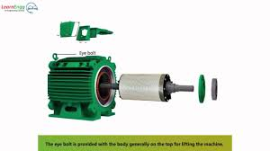
General types of induction motors
Squirrel cage induction motor
Its rotor is self-contained and resembles a squirrel cage. The rotor conductors are permanently short-circuited by end-rings.

Slide 30
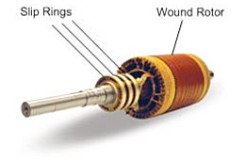
General types of induction motors
Wound rotor or phase wound or rotor induction motor or slip-ring motors
Its rotor has insulated coils of wire and resembles a DC armature. The rotor conductors are connected to slip rings and shorted thru the brushes.

Slide 31
Distinction between Squirrel cage and wound rotor induction motors
Squirrel cage induction motor | Wound Rotor Induction Motor
Copper losses is low | Copper losses is high
Starting torque is low but running torque is good | Starting torque is higher than squirrel cage induction motor
Efficiency is high due to low resistance | Efficiency is low
Speed can be varied by changing poles | Speed can be varied very slightly by changing the extra rotor resistance
Speed is nearly constant but slightly falls with load | More speed falls with load
Starting current is high | Starting current is low
Applications: Printing machine Flour mills Saw mills Lathe Blower mills | Applications: Rolling mills Flour mills Lifts Crane erector

Slide 32
REferences
Pertuzella, F. D. (2010). Electric Motors and Control Systems (1st ed.). New York: McGraw-Hill
http://www.robotplatform.com/knowledge/actuators/dc_motors.html

Slide 33
END of Chapter 2

